Slide 1
Data visualization using Tableau
Data visualization is a process used to represent the data in the graphical format.
It is because of data visualization that various decision makers can gain insights as well as patterns and analyze it from the data represented visually.
Data visualization makes us think differently about the information to develop value out of it.
Performing data visualization is not an easy task. One needs to be very careful when using different data visualization techniques and plotting the data.
Various decision makers and stakeholders consider three major factors while performing data visualization:
Clarity – Clarity is achieved when the data to be visualized is appropriate and thorough. The absence of clarity in data yields false patterns which may lead to wrong implications on the new appropriate data.
Accuracy – Once you have achieved clarity, it is important to use suitable pictorial representation.
Efficiency – Efficiency plays a very important role in data visualization. One should ensure using proper data visualization techniques that showcase all the necessary data points.

Slide 2
Advantages of Data visualization
Advantages of Data Visualization
It helps to recognize relationships among various variables in the data.
It makes it easier to perform mathematical calculations.
It is beneficial to analyze and explore the existing patterns, thus giving out the invisible patterns.
It helps to recognize the areas that need to be improved.
There are many data visualization tools in the market which make the task of visual representation of the huge datasets significantly easier.
These tools are used to display data in dashboards, reports, or simply anywhere you want to interpret data visually.
Some of such data visualization tools are Whatagraph, Power BI, Tableau, etc.

Slide 3
Introduction to Tableau
Tableau is a strong and rapidly expanding data visualization tool.
It is highly used in the business intelligence domain.
Tableau simplifies raw data into a format that is simple and easily intelligible.
Tableau makes data analysis easy and rapid.
Data visualizations created in the Tableau are along the lines of worksheets and dashboards.
The user does not need to be familiar with any technical knowledge or programming skills to use the Tableau software; thus, this data visualization tool has attracted many people from various domains.

Slide 4
Important Features in Tableau
Data Blending – Data blending plays a vital role in data analysis and visualization and hence is the supreme feature in Tableau. Data blending comes in a role where we merge the relevant data from various sources to analyze it in one view and portray it visually using graphs.
Real-Time Analysis – When the speed is high and the dynamic real time analysis of the data becomes complex, real-time analysis helps the user to rapidly comprehend and analyze the real-time data. Thus, Tableau helps in extracting important information from the rapidly moving real-time data with collective analysis.
A Collaboration of Data – Data analysis is not a separating task; it needs a collaboration medium for the team members, and this is the reason that Tableaus provide us with the collaboration of data. Team members can share various forms of data, take follow-ups from one another, and share easy visualizations so that others get values from the data. It is critical to make sure that everybody can comprehend the data and conclude vital decisions.

Slide 5
Analytics Cycle
A person who goes well along with data and tries to comprehend the data moves within the analytics cycle. The analytics cycle can be explained as below:
Because of the Tableau, you can move candidly within the steps and iterate along the analytics cycle and get answers to the questions or even frame new questions.
Data Discovery – Exploring the data becomes easier with Tableau and understand the data that can be plotted visually.
Data Preparation – As mentioned above, data from various sources can be merged in Tableau. Tableau provides various functionalities that make complex and messy data come together.
Data Analysis – Data visualization is easier with Tableau. With Tableau, one can get familiar with the trends, recognize the outliers. Tableau provides us with various functionalities that allow us to get deep into complex patterns and correlations of data.
Data Storytelling – With Tableau, we can build dashboards and stories along with visualizations so that the audience understands the story behind your visualizations better.

Slide 6
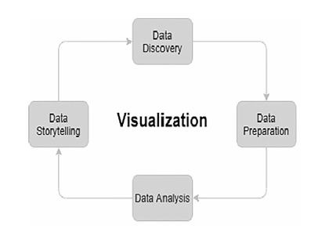
Analytics Cycle
Analytics cycle.

Slide 7
Advantages of Tableau
Tableau creates an automatic dashboard. Also, when the dashboard is to be opened on the mobile phone, it automatically identifies the handset and adjusts the dashboard accordingly.
Tableau can handle millions and trillions of data without slowing down the dashboard performance.
Complicated computations can be performed by incorporating Tableau with Python and R.

Slide 8
Disadvantages of Tableau
Tableau does not provide total security. One can only get row-level security.
Tableau does not automatically update the Tableau reports. One has to always manually do it at the back end.
Similar formatting for numerous fields cannot be performed at the same time.

Slide 9
Dimensions and Measures
Once you have imported the data file into Tableau, the connections and the fields in the data are displayed in the data pane on the left of the screen. Different fields are dragged on the canvas area as per the requirements. The placements of the fields onto various shelves, such as the Rows shelf and Columns shelf, will result in diverse results.
The fields of the data source are placed under dimensions and measures by Tableau itself when displayed in the data pane. When using Tableau, it is essential to know what dimensions and measures exactly are:
Dimensions – Dimensions are the fields that have qualitative information (values). Dimensions are mostly used to classify and divide the details of the data. Dimensions unfold the details in the data and control the intensity of details to be displayed in the visualization.
Measures – Measures are referred to as the fields that have quantitative values that can be used to perform numeric calculations such as sum, average, count, minimum, maximum, standard deviation, etc. By default, when a measure is drawn to the canvas area, the aggregation method is applied to it by Tableau.

Slide 10
Dimensions and Measures
In the Tableau, the fields are represented using two colors − blue and green, when they are dragged to the respective shelves.
The green fields (dimensions and measures) represent the continuous nature of the values. A continuous field defines the axis in the view.
The blue fields (dimensions and measures) represent the discrete nature of the value that is all the unique values that are different from one another. The discrete field defines headers in the view.
Let’s take an example of the Superstore data from the Tableau repository.
Suppose, we want to look at the profit earned by each category. As shown below, you can see that the dimension field named Category is added to the Columns shelf, and in the bar chart below, it has added a header in the view. Similarly, the measured field named Profit is added to the Rows shelf and this field adds an axis in the view (Figure).

Slide 11
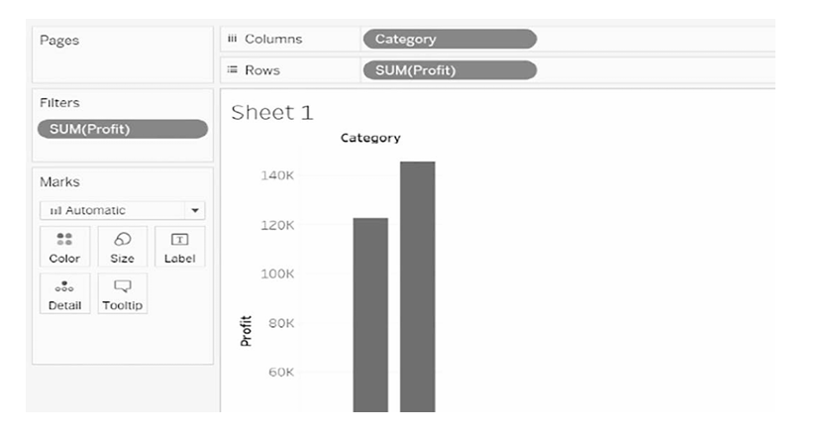
Dimensions and Measures
Dimensions and measures example.

Slide 12
Dimensions and Measures
Also, one can notice that the category field is a discrete (blue) field and has unique values – furniture, office supplies, and technology, whereas the profit field which is a measure is continuous (green), and it has various values within the profit range.
One common misunderstanding that everyone makes is that they consider dimensions and measures to be the same as discrete and continuous fields.
Most of the time, we come across discrete dimensions and continuous measures.
Moreover, you can convert a continuous measure to a discrete measure and a few discrete dimensions to continuous dimensions.

Slide 13
Descriptive Statistics
Statistical analysis plays a pivotal role in data science.
Descriptive statistics are on high demand as it assists review, analyze, and gain insights into the data.
Descriptive statistics is a method that summarizes and describes the data to gain insights into them.
Descriptive statistics are the numbers that describe the data, and this description is not used to conclude anything.
As we know, there are two types of descriptive statistics; the first is the measures of central tendency such as the mean, median, and mode, and the second is the measure of dispersion such as the standard deviation and variance.
For a data scientist, it is mandatory to know these techniques. Tableau provides us with easy statistical functions that help to perform these techniques much easier.
Let’s take a look at these descriptive statistics methods in Tableau using the sample superstore dataset from the Tableau repository.

Slide 14
Mean
The mean, also known as the average of the data, is calculated by adding all the values and dividing by the number of values.
In the Tableau, it is easy to calculate the mean using the average function. Suppose, we want to know the average sales in each category.
To calculate such an average, we will need to execute the following steps:
Step 1: Drag the dimension Category and the measure Sales to the canvas area.
Step 2: To get the average, right-click on the Sales field and select the Measure (Average) method.
Step 3: To get the average to be displayed on the respective bars, drag the Sales field from the canvas area itself to the Label property under the Marks shelf (Figure).

Slide 15
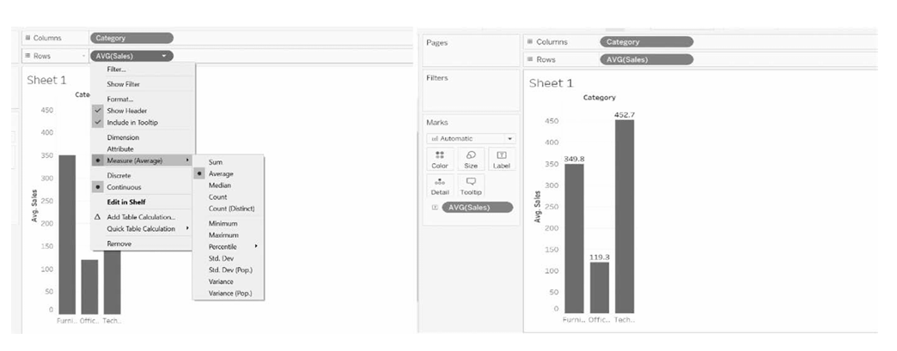
Mean
Average function example

Slide 16
Median
The median is the middle value in the data.
It is the value that divides the dataset into two parts. The median is also known as the 0th percentile of the dataset.
Say, we want to know the median profit in each category. Execute the following steps to get the median:
Step 1: Drag the dimension Category and the measure Profit to the canvas area. (As shown in the picture below, we have used the Packed Bubbles chart.)
Step 2: To get the median, right-click on the Profit field and select the Measure (Median) method.
Step 3: To get the packed bubbles in different colors and in different sizes, drag the Category field to the Color property and the MEDIAN(Profit) to the Size property under the Marks shelf, respectively.
Step 4: To get the median to be displayed on the respective bubbles, drag the Category and the Profit field from the canvas area itself to the Label property under the Marks shelf (Figure).

Slide 17
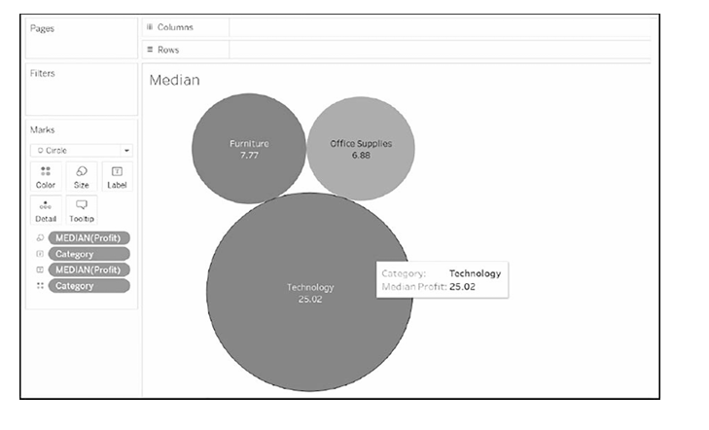
Median
Median function example

Slide 18
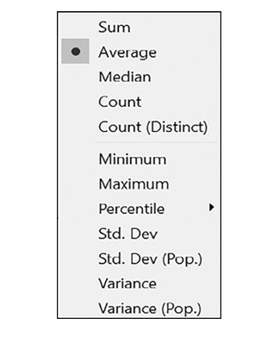
Similarly, we can calculate the below descriptive statistics methods in Tableau.
Descriptive statistics functions provided by Tableau.

Slide 19
Worksheet Summary Card
Tableau also provides us a feature known as the Summary Card. The Summary Card gives us a summary of the visuals we have plotted in the canvas area.
The Summary Card provides all the descriptive statistics methods we covered above.
Let’s take the example that we did while calculating the median using the packed bubbles. To get the Summary Card for this example, the following steps must be carried out.
Step 1: In the tab window, right-click the Worksheet tab and select Show Summary. Once you click on the Show Summary, the Summary Card will be activated on the right of the screen.
Step 2: You can place this Summary Card anywhere by just dragging it on the screen.
Step 3: Right-click on the Summary tab in the Summary Card and select or deselect the metrics as per the requirements (Figure).

Slide 20
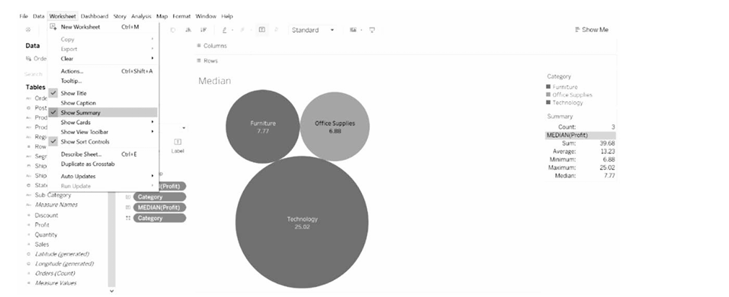
Worksheet Summary Card
Worksheet Summary Card example

Slide 21
Basic Charts
Tableau can provide interactive charts. Different types of charts are created using various measures and dimensions.
The Show Me tab suggests various chart types based on the measures and dimensions selected by the user.
A bar chat appears on the canvas area by default when a dimension is selected followed by a measure.
Similarly, a textual representation of data is displayed on the canvas area when a measure is selected followed by a dimension.

Slide 22
Basic Charts
The following are the various types of basic charts in Tableau.
Bar chart
Area chart
Line chart
Bullet chart
Scatter plot
Box-whisker plot
Pie chart
Bubble chart
Histogram
Highlight table
Gantt chart
Heat map

Slide 23
Area Chart
Area charts are mostly used to analyze numeric data over different time periods.
The area chart is just an extension to the line chart where the area between the lines and the axis is filled with color.
Suppose, we want to analyze the Sales per category over the Order Date.
We will create an area chart to analyze such a scenario.
Execute the following steps to create an area chart:
Step 1: Drag the dimension Order Date to the Columns shelf and the measure Sales to the Rows shelf.
Step 2: Change the chart type from Automatic to Area under the Marks pane.
Step 3: Change the Order Date type to Month.
Step 4: Drag the dimension Category to the Colors property under the Marks pane.

Slide 24
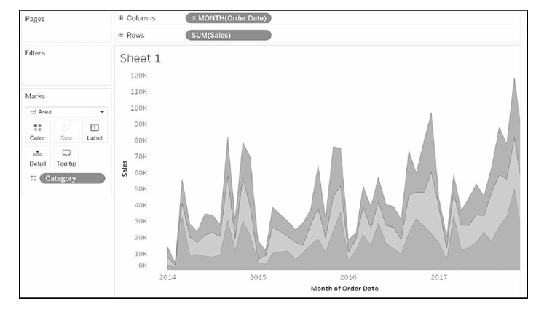
Area Chart
Area plot.

Slide 25
Scatter Plot
Scatter plots are used to find relationships between two or more variables. Scatter plots are majorly used to find out trends in the data.
A scatter plot displays discrete data points on the graph. Say, we have to find the relationship between the sales and the profit based on the subcategory.
To create a scatter plot, perform the following steps:
Step 1: Drag the measures Sales and Profit to the Columns and Rows shelves, respectively.
Step 2: Drag the dimension Sub-Category to the Colors property under the Marks pane (Figure).

Slide 26
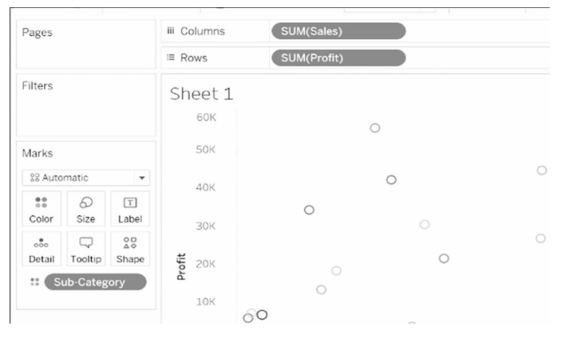
Scatter Plot
Scatter plot.

Slide 27
Box-Whisker Plot
Box-whisker plots are also known as the boxplots.
Box-whisker plots are normally used to showcase the data distributions. The box in the plot represents the first, second, and third quartiles.
The whiskers represent the maximum and the minimum data points of the data.
Let’s learn to plot a box-whisker plot in Tableau.
Step 1: Drag the dimension Segment and measure Discount to the Columns and Rows shelves, respectively.
Step 2: Drag the dimension Region to the right of the Segment in the Columns shelf.
Step 3: Select the box-whisker plot under the Show me tab.
Step 4: Replace the dimension Region in the Marks shelf to the right of the dimension Segment under the Columns shelf.
Step 5: Deselect Aggregate Measures under the Analysis tab.
Step 6: Edit the colors by right-clicking the vertical axis and selecting Edit Reference Line (Figure).

Slide 28
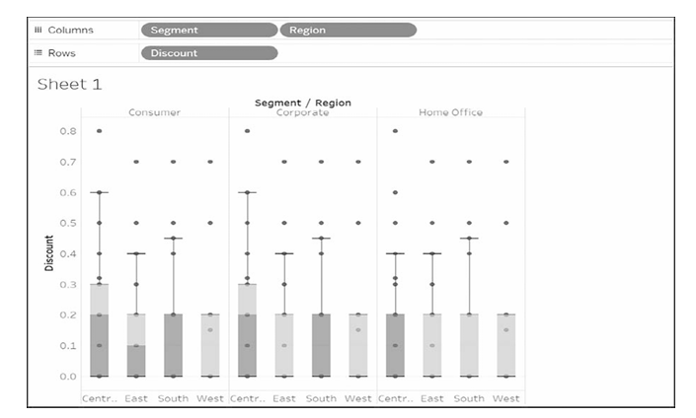
Box-whisker Plot
Box-whisker plot.

Slide 29
Heat Map
Heat maps are majorly used to analyze the data with various categories using colors.
The heat map can compare hundreds and thou sands of categories and make it simple to interpret.
Suppose, using the Sample Superstore dataset, we want to analyze the trends in the data of the Sales in accordance with the Order Date by plotting a line graph.
Such a line graph will create an overlapping of lines which will cause trouble to analyze the graph. In such cases, a heat map is a better alternative to find the trends in data.
Perform the following steps to create a heat map in the Tableau.
Step 1: Drag the dimension Order Date and dimension Sub-Category to the Columns and Rows shelves, respectively.
Step 2: Change the Order Date type to Month.
Step 3: Change the Mark type to Circle under the Marks tab.
Step 4: To get the encoding, drag the measure Sales to the Colors and Size property under the Marks tab (Figure).

Slide 30
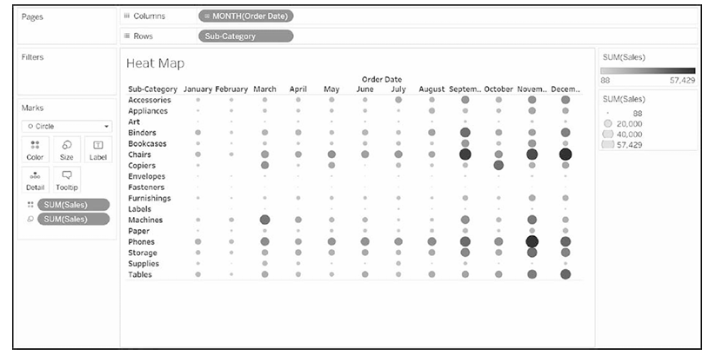
Heat Map
Heat map

Slide 31
Dashboard Design & Principles
A dashboard is an interactive representation of united worksheets and all the essential information.
Dashboards are mainly used to compare various data at one go.
Let us create a dashboard from the Sample Superstore dataset to analyze the profit performance by the country.
Step 1: Go to the new dashboard worksheet by navigating the Sample Superstore sheet.
Step 2: Drag the sheets from the left of the dashboard section to the canvas area. You can also add them by double-clicking the sheets.
Step 3: Check the Show Dashboard Title and add the dashboard title.
Step 4: Fit the view with respect to the available space.
Step 5: Place the Profit legend with respect to the sheet.
Step 6: Take your time to interact with the dashboard (Figure)

Slide 32
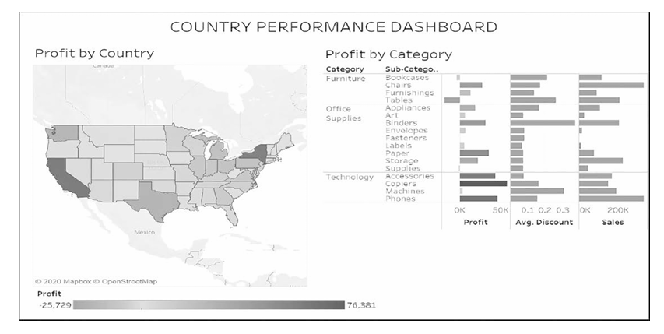
Dashboard design principles
Country performance dashboard

Slide 33
Dashboard design principles
Dashboard design principles play a vital role in the process of creating a dashboard.
Using the below principles, one will easily be able to make inter active, data-driven dashboards.
Be the audience You should always think from the side of your audience, the group of people who are going to view your dashboard on a laptop or a projector screen.
Relevant dashboard Create dashboards that can fit into every type of screen, be it smartphones, laptops, tablets, etc.
Use minimal types of color Be consistent with the colors, and use the gradients of the relevant colors.
Layout design The most significant trend should be easily visible to the user. Place the comparative views beside each other.

Slide 34
Special Chart Types
All Tableau users know the basic charts and graphs that can be easily plotted using the Show me tab which contains various charts, such as line chart, pie chart, heat maps, treemaps, etc.
To make the visualization more interactive on the dashboard, Tableau also provides some advanced graphs that need a bit more computations than the graphs shown under the Show me tab.
The following are the advanced graphs:
1. Motion chart
2. Bump chart
3. Waterfall chart

Slide 35
Motion Chart
A motion chart is nothing but a chart that shows the transformation in data dynamically.
Suppose, we want to dynamically see the trends of profit and sales over the years.
A motion chart is created in the Tableau by performing the following steps:
Step 1: Drag the dimension Order Date to the Columns shelf and measures Profit and Sales to the Rows shelf.
Step 2: Change the format of the Order date to Month-Year by right clicking on it and then clicking on Custom under the More tab as shown below (Figure).
Step 3: Drag the dimension Order Date to the Pages shelf and change the format accordingly.
Step 4: To recognize the current trend in the run-time motion chart, change the mark type under the Marks shelf from Automatic to All.
Step 5: Set the show to Trails under the Show history visible on the right side of the window.

Slide 36
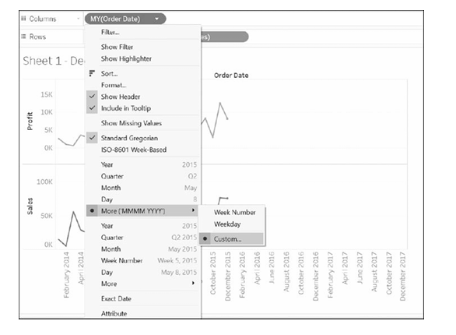
Motion Chart
Changing the format for the motion chart.

Slide 37
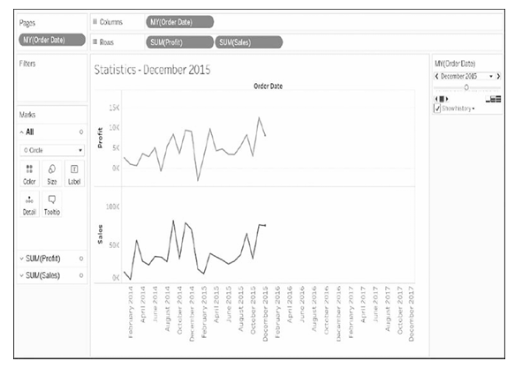
Motion Chart
Motion chart example

Slide 38
Bump Chart
Say, you want to look at the sales of different categories in a year.
You can do this using a basic line chart, but a bump chart will give you more detailed results of the same problem.
Bump charts are mostly used to get an idea of the change in the approval of products over years.
Let’s learn to plot a bump chart:
Step 1: Bump charts are created based on ranks. So, first, create a calculated field as shown below (Figure):
Step 2: Drag Order Date to the Columns shelf and change its format to Month. Drag Category to the Colors property under the Marks pane. Also, drag the newly created calculated field Rank to the Rows shelf.
Step 3: To allocate the rank by the categories, right-click the Rank → Compute Using → Category.

Slide 39
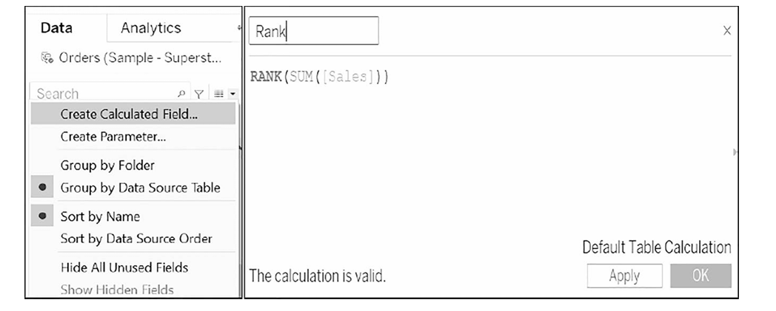
Bump Chart
Creating a calculated field

Slide 40
Bump Chart
Step 4: Drag the calculated field Rank to the Rows shelf again and repeat Step 3.
Step 5: Right-click on the second Rank in the canvas area, and select Dual Axis.
Step 6: Alter the Mark type to Circle of either of the Rank under the Marks pane.
Step 7: Ranks can be reversed by the following navigation – Click on the axis → Edit Axis → Reversed Scale. The bump chart is ready (Figure).

Slide 41
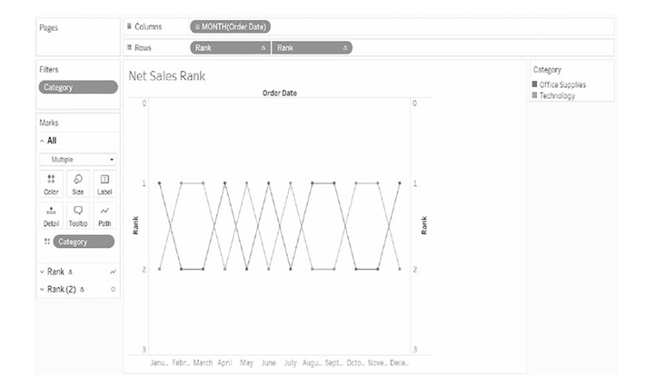
Bump Chart
Bump chart

Slide 42
Waterfall Chart
A waterfall chart is exactly what it means; it depicts the flow between certain statistics.
A line chart is replaced by a waterfall chart as it is more interactive. A waterfall chart is used to analyze a measure – its rise and fall over the years.
Here, we will see the flow of sales over the years. To achieve this, execute the following steps:
Step 1: Drag the Order Date and Profit to Columns and Rows shelves, respectively. Change the format of the Order Date to Month Year and for the Profit, convert the Quick Table Calculation to Running Total.
Step 2: Under the Marks pane, change the Mark type to Gantt Bar. You can also alter the size accordingly.
Step 3: Create a calculated field named Negative Profit and drag it to Size under the Marks pane. This field will fill the Gantt chart.
Step 4: Drag Profit to the type Color under the Marks pane (Figure).

Slide 43
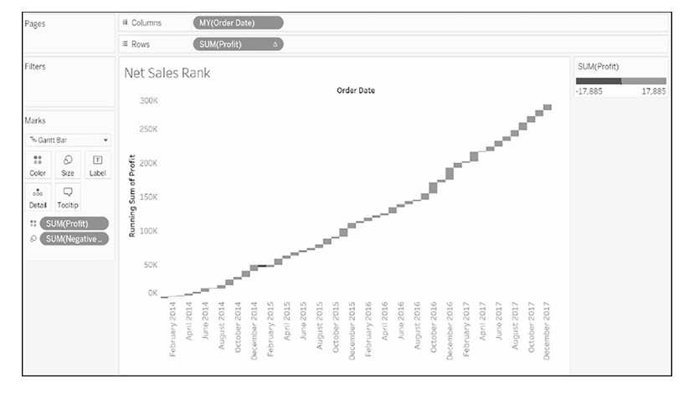
Waterfall Chart
Waterfall chart.

Slide 44
Integrate Tableau with Google Sheets
Google Sheets is a spreadsheet utility bestowed by Google.
Google Sheets is a web-based application and free of cost.
It is now possible to integrate Google Sheets in Tableau using the Google Sheets connector.
Tableau is strongly sup ported by Application Programming Interface (API) which helps us to get a seamless connection and gather productive insights.
To integrate Google Sheets in Tableau, execute the following steps:
Step 1: Open the Tableau application on your device, go to the connect column, and select Google Sheets under the To a Server tab.
Step 2: After Step 1, you will be directed to a page asking to sign into your Google account.
Step 3: Grant Tableau permission to access the Google Sheets.
Step 4: Select the desired Google Sheet to integrate with Tableau (Figure).

Slide 45
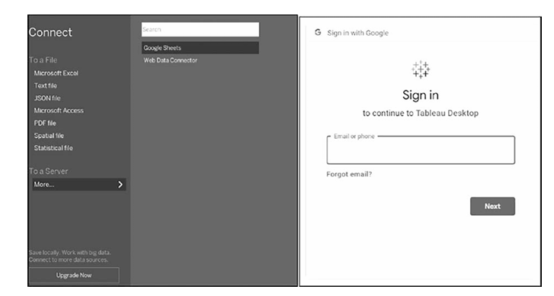
Integrate Tableau with Google Sheets
Integrating Google Sheets in Tableau.

Slide 46
Integrate Tableau with Google Sheets
Although one can now connect Google Sheets in Tableau, it does have certain limitations. They are as follows:
i. Tableau is not supported by dynamic updates. Changes made in the Google Sheet would not be reflected in Tableau immediately.
ii. Composite transformations are not possible in Tableau; it affects the performance.
iii. Using joins to connect various data sources, including Google Sheets, is a tedious task.
iv. Team-drive accounts cannot be used to integrate Google Sheets in Tableau.

